Slide 1
GROWTH PLAN
VISION
Enter vision here
Line two if needed
Period:
Date:
Version:
AUDIENCE AND MESSAGE
STRATEGIES
RESOURCES
TARGET PERSONA / AUDIENCE
OUTCOMES
CHANNELS
MARKETING
SALES
PROPOSITION / OFFER
CONTEXT
FINANCIALS
ISSUES / BARRIERS
OPPORTUNITIES
CUST & REV
COSTS
POSITIONING & KEY MESSAGES
STRATEGIES
RESOURCES

Slide 2
STRATEGY 1
VISION/ GOAL
Period:
Date:
Version:
STRATEGY
MEASURES / OUTCOME
TACTICS
RISKS / OPPORTUNITIES

Slide 3
TACTICAL EXECUTION
VISION/ GOAL
Period:
Date:
Version:
TACTIC
OUTCOME
METRICS
STRATIGIC
TACTIC
Activity | J | F | M | A | M | J | J | A | S | O | N | D | Owner | RAG | Notes / Update
RAG STATUS: At risk, Some Risk On Track Not Started Completed

Slide 4
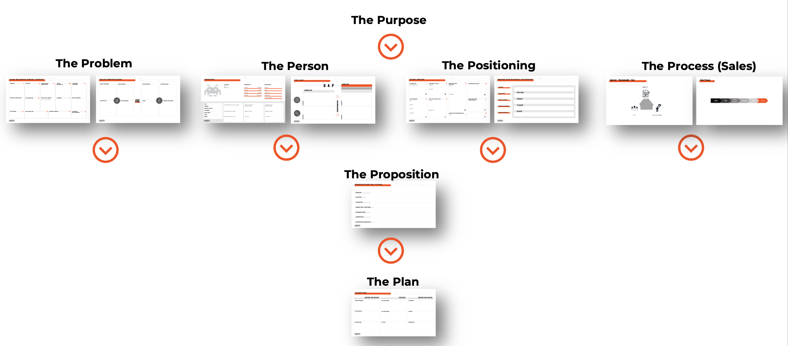
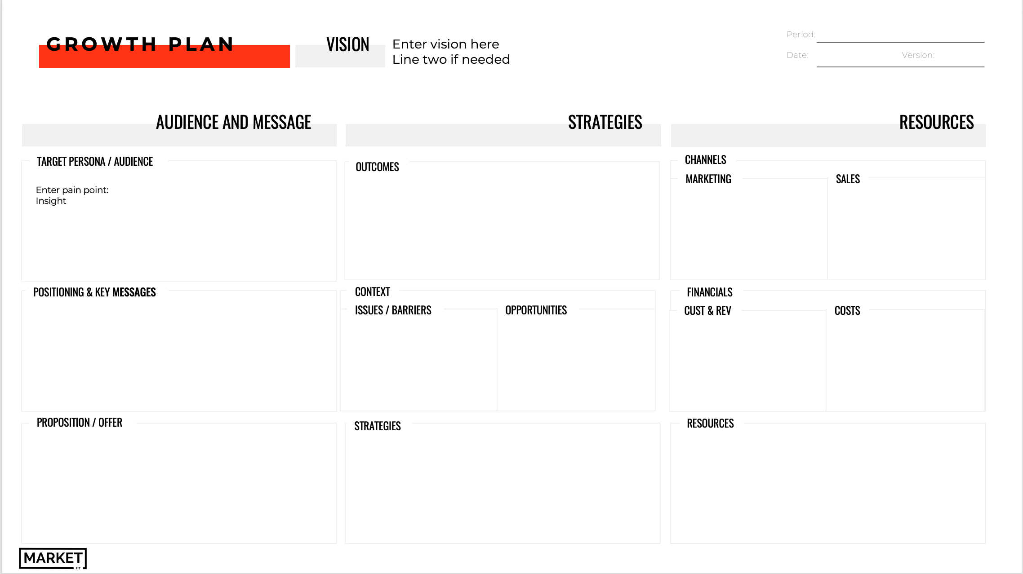
HOW WE CAN HELP
Planning is hard, it can be frustrating, as it forces prioritisation and alignment. And if not done right it can drag on forever.
We believe true growth can only happen when your strategy and tactics are built on the of alignment of product, customer, positioning and proposition.
This can be achieved through applying the Market Fit Growth Strategy Framework.
We have developed an intensive one day workshop process working with you and your team to quickly & simply create an integrated growth plan, one your whole business will buy into.
You and your team will leave with a cohesive understanding of how the elements work together, any gaps that need to be filled and the strategy, tactics and resources to achieve your growth goals.
And more importantly a step by step 90-day plan to get your sales and growth back on track, that you can implement immediately.
If you want more information you can email kursten@marketfit.co or book a meeting with Kursten via this link

